Slide 1
Operating System -Structures

Slide 2
Chapter 2: Operating-System Structures
Operating System Services
User Operating System Interface
System Calls
Types of System Calls
System Programs
Operating System Design and Implementation
Operating System Structure
Operating System Debugging
Operating System Generation
System Boot

Slide 3
Objectives
To describe the services an operating system provides to users, processes, and other systems
To discuss the various ways of structuring an operating system
To explain how operating systems are installed and customized and how they boot

Slide 4
Operating System Services
Operating systems provide an environment for execution of programs and services to programs and users
Helpful OS services provided to the user:
User interface - Almost all operating systems have a user interface (UI).
Varies between Command-Line (CLI), Graphics User Interface (GUI), Batch
Program execution - The system must be able to load a program into memory and to run that program, end execution, either normally or abnormally (indicating error)
I/O operations - A running program may require I/O, which may involve a file or an I/O device

Slide 5
Operating System Services (Cont.)
File-system manipulation - The file system is of particular interest. Programs need to read and write files and directories, create and delete them, search them, list file Information, permission management.
Communications – Processes may exchange information, on the same computer or between computers over a network.
Communications may be via shared memory or through message passing (packets moved by the OS)
Error detection – OS needs to be constantly aware of possible errors
May occur in the CPU and memory hardware, in I/O devices, in user program
For each type of error, OS should take the appropriate action to ensure correct and consistent computing
Debugging facilities can greatly enhance the user’s and programmer’s abilities to efficiently use the system

Slide 6
Operating System Services (Cont.)
OS functions for ensuring the efficient operation of the system itself via resource sharing
Resource allocation - When multiple users or multiple jobs run concurrently, resources must be allocated to each of them
Many types of resources - CPU cycles, main memory, file storage, I/O devices.
Accounting - To keep track of which users use how much and what kinds of computer resources
Protection and security - The owners of information stored in a multiuser or networked computer system may want to control use of that information, concurrent processes should not interfere with each other
Protection involves ensuring that all access to system resources is controlled
Security of the system from outsiders requires user authentication, extends to defending external I/O devices from invalid access attempts

Slide 7
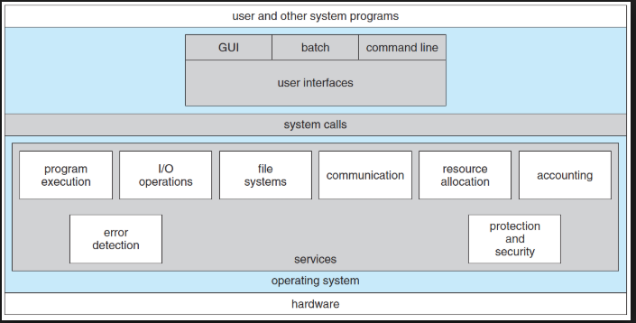
A View of Operating System Services

Slide 8
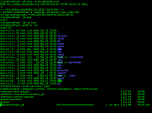
User Operating System Interface - CLI
A command-line user interface (CLI), also known as a console user interface, and character user interface (CUI), is a means of interacting with a computer program where the user (or client) issues commands to the program in the form of successive lines of text (command lines).

Slide 9
User Operating System Interface - GUI
User-friendly desktop metaphor interface
Usually mouse, keyboard, and monitor
Icons represent files, programs, actions, etc
Various mouse buttons over objects in the interface cause various actions (provide information, options, execute function, open directory (known as a folder)
Invented at Xerox PARC
Many systems now include both CLI and GUI interfaces
Microsoft Windows is GUI with CLI “command” shell
Apple Mac OS X is “Aqua” GUI interface with UNIX kernel underneath and shells available
Unix and Linux have CLI with optional GUI interfaces (CDE, KDE, GNOME)

Slide 10
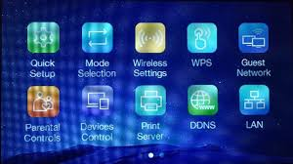
Touchscreen Interfaces
Touchscreen devices require new interfaces
Mouse not possible or not desired
Actions and selection based on gestures
Virtual keyboard for text entry
Voice commands.

Slide 11
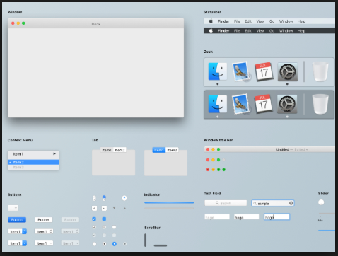
The Mac OS X GUI

Slide 12
System Calls
System calls provide an interface between the process and the operating system.
System calls allow user-level processes to request some services from the operating system which process itself is not allowed to do.
In handling the trap, the operating system will enter in the kernel mode, where it has access to privileged instructions, and can perform the desired service on the behalf of user-level process.
It is because of the critical nature of operations that the operating system itself does them every time they are needed.
For example, for I/O a process involves a system call telling the operating system to read or write particular area and this request is satisfied by the operating system.

Slide 13
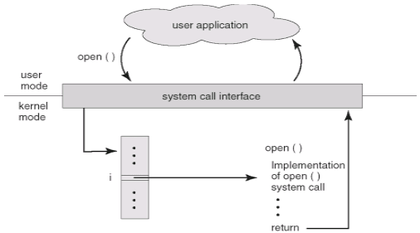

Slide 14
Types of System Calls
Process control
create process, terminate process
end, abort
load, execute
get process attributes, set process attributes
wait for time
wait event, signal event
allocate and free memory
Dump memory if error
Debugger for determining bugs, single step execution
Locks for managing access to shared data between processes

Slide 15
Types of System Calls
File management
create file, delete file
open, close file
read, write, reposition
get and set file attributes
Device management
request device, release device
read, write, reposition
get device attributes, set device attributes
logically attach or detach devices

Slide 16
Types of System Calls (Cont.)
Information maintenance
get time or date, set time or date
get system data, set system data
get and set process, file, or device attributes
Communications
create, delete communication connection
send, receive messages if message passing model to host name or process name
From client to server
Shared-memory model create and gain access to memory regions
transfer status information
attach and detach remote devices

Slide 17
Types of System Calls (Cont.)
Protection
Control access to resources
Get and set permissions
Allow and deny user access

Slide 18
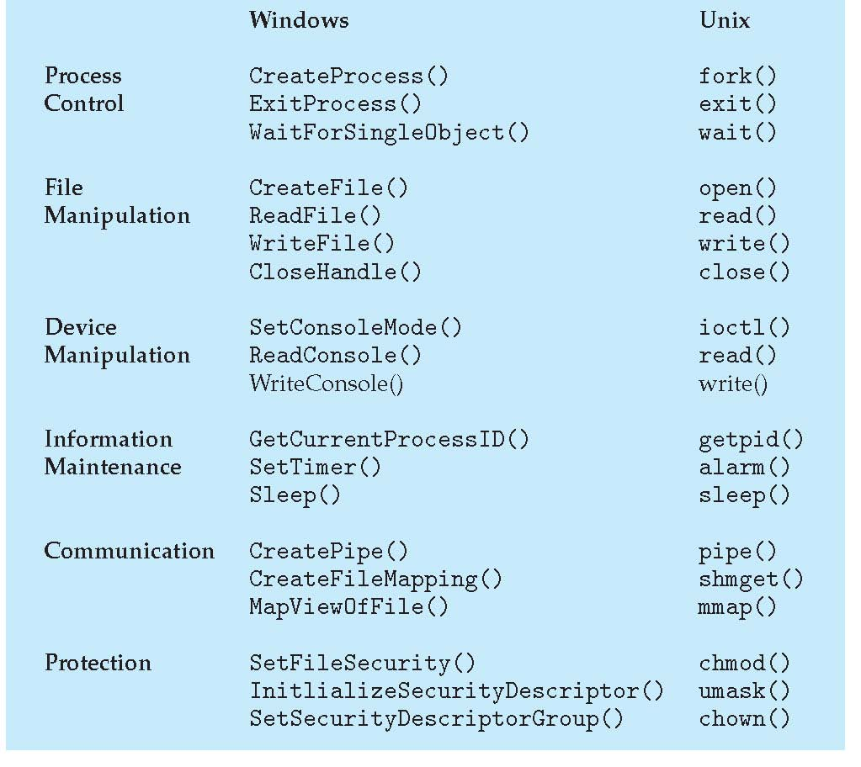
Examples of Windows and Unix System Calls

Slide 19
System Programs
As it controls a specific aspect of the computer operations, system program provides a convenient environment for program development and execution
Some of them are simply user interfaces to system calls; others are considerably more complex
File management - Create, delete, copy, rename, print, dump, list, and generally manipulate files and directories
Status information
Some ask the system for info - date, time, amount of available memory, disk space, number of users
Others provide detailed performance, logging, and debugging information
Typically, these programs format and print the output to the terminal or other output devices
Some systems implement a registry - used to store and retrieve configuration information

Slide 20
System Programs (Cont.)
File modification
Text editors to create and modify files
Special commands to search contents of files or perform transformations of the text
Programming-language support - Compilers, assemblers, debuggers and interpreters sometimes provided
Program loading and execution- Absolute loaders, relocatable loaders, linkage editors, and overlay-loaders, debugging systems for higher-level and machine language
Communications - Provide the mechanism for creating virtual connections among processes, users, and computer systems
Allow users to send messages to one another’s screens, browse web pages, send electronic-mail messages, log in remotely, transfer files from one machine to another

Slide 21
System Programs (Cont.)
Background Services
Launch at boot time
Some for system startup, then terminate
Some from system boot to shutdown
Provide facilities like disk checking, process scheduling, error logging, printing
Run in user context not kernel context
Known as services, subsystems, daemons
Application programs
Don’t pertain to system
Run by users
Not typically considered part of OS
Launched by command line, mouse click, finger poke

Slide 22
Operating System Design and Implementation
Design and Implementation of OS not “solvable”, but some approaches have proven successful
Internal structure of different Operating Systems can vary widely
Start the design by defining goals and specifications
Affected by choice of hardware, type of system
User goals and System goals
User goals – operating system should be convenient to use, easy to learn, reliable, safe, and fast
System goals – operating system should be easy to design, implement, and maintain, as well as flexible, reliable, error-free, and efficient

